Slide 1



When One or Both Spouses Have Experienced Trauma:
Cultivating Rythyms of Grace and Healing
Ron Wood, LPC,LADC
Halee Wood, CLC, CRC
Run the Race Together
Bright Tomorrows - October 30, 2025

Slide 2
Today, we will learn...
  How to recognize trauma
  Common responses to trauma in a marriage
  Practical strategies to navigate trauma responses as a couple
  Practical guidance for each individual spouse
OVERALL: HEALTHY TRAUMA RESPONSES
so that...
  We can respond to the trauma not the behavior
  Create space for responsibility, empathy, and spiritual wholeness for the individual and the couple
  The trauma doesn’t get the control or the last word
OVERALL:
THE PAIN CAN BECOME A CATALYST
FOR TRUST AND INTIMACY!

Slide 3
Recognizing Trauma
Taxonomy of Trauma
by Ibrahim Aref Kira, Ph.D
First Taxonomy of Trauma: based on trauma’s impact on five areas of individual functioning.
  reflects how a traumatic event can disrupt the individual's sense of self, social connections, and ability to achieve personal goals.

Slide 4
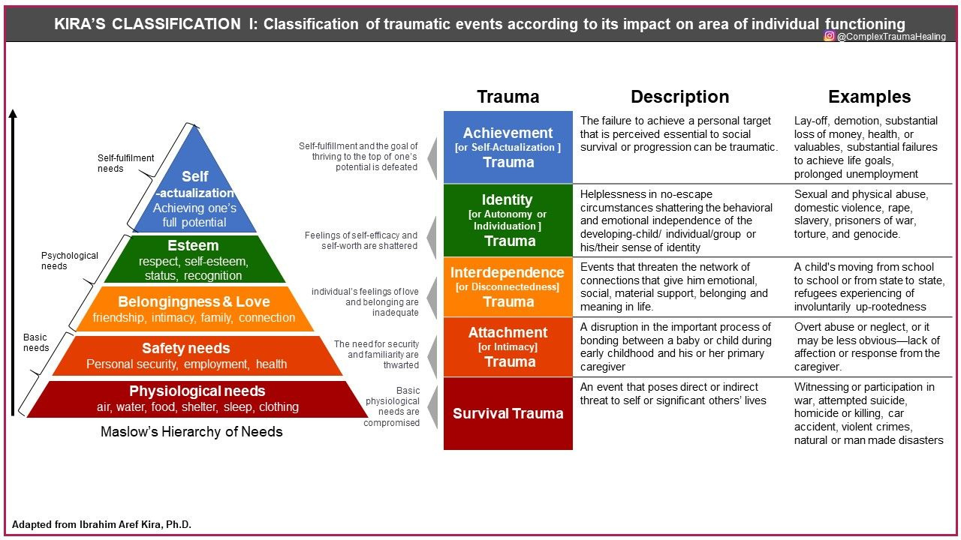
First Taxonomy of Trauma

Slide 5
Recognizing Trauma
Taxonomy of Trauma
by Ibrahim Aref Kira, PhD
Second Taxonomy of Trauma: based on objective or external characteristics.
  Trauma-like events: accumulation of multiple, non-traumatic stressors over time
  Real traumatic events: Direct, Indirect/Vicarious, Cross-Generational (via Family or Collective Transmission)

Slide 6
Common Trauma Responses
and how they affect marriages
  “Unnecessary” Survival Skills: woven deeply into the fabric of the individual; often seen as strength... until it’s not.
  Triggers: a conscious or unconscious reliving of the trauma
    Flipping the lid
    Dissociation

Slide 7
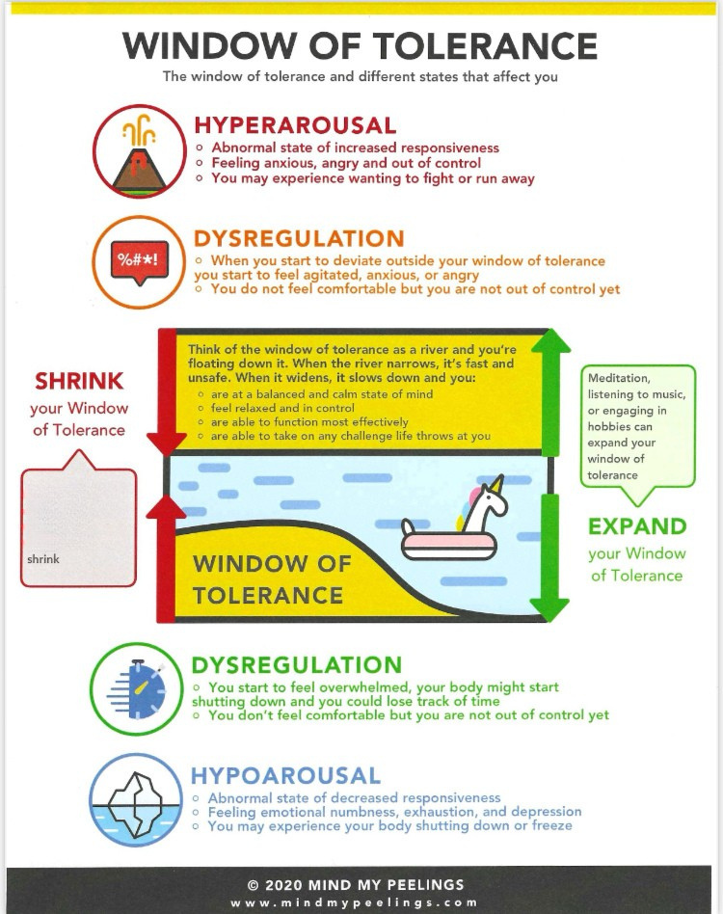
Window of Tolerance
and different states that affect you
© 2020 MIND MY PEELINGS
www.mindmypeelings.com
Stress and trauma
can cause your
window of
tolerance to

Slide 8

Practical Strategies
for the couple
Tips for Time-Outs - Make a Plan
  Learn to recognize when a time-out is needed
  Agree on a signal to begin a time-out
  Determine the length of time (no more than 24 hours)
  Discuss ideas for a healthy way to spend the time-out

Slide 9

Practical Strategies
for the couple
Listen Well - REAP
R -
E -
A -
P -
Reflect
Empathize
Affirm
Problem Solve (if necessary) or Pause for Time-Out

Slide 10


Practical Strategies
for the couple
Diffuse Tension. Create Unity. - Collaborative Communication
A: observation
What can I see, feel, or touch?
No moral judgements
"When you do A,
I feel B
because I need C.
It would be really helpful if you could D."
B: feeling
How am I feeling about what someone else is doing?
Do not add additional thoughts or stories.
C: need
What do I desire/need?
Most frustration is based on a perceived unmet need.
d: request
What specific action would I like to try?
Do not demand it; request it.

Slide 11
tips
for the regulated partner
  Protect your marriage and support your spouse.
  Care for yourself while your spouse is healing.

Slide 12
tips
for the trauma survivor
  Take responsibility for your trauma response.
  Don’t shame or deny your partner’s reality.
  Be transparent and communicate clearly.
  Remember your value/worth.

Slide 13
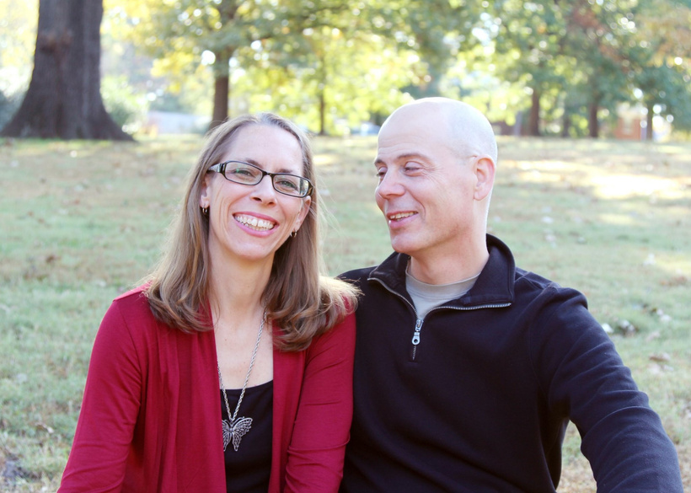
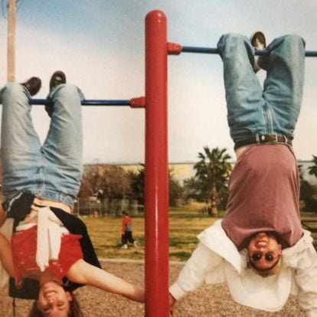


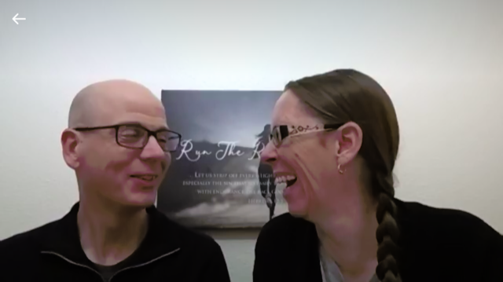
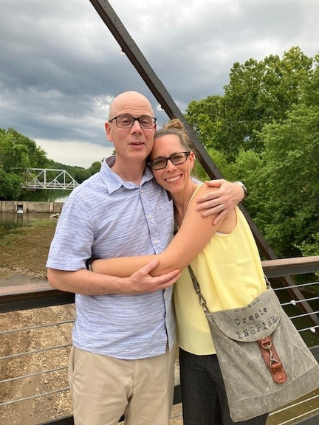

www.RunTheRaceTogether.com
@RunTheRaceTogether
info@RunTheRaceTogether.com

